Slide 1
Open Source Software: WordPress
LI815
Dawn Brumbley

Slide 2
What is it?
In 2001 it started as just a blogging system, but now it can be used to support a full-fledged website.
It is an Open Source Content Management System (CMS), and the community of users are the developers of the system.
“lets you manage your website more efficiently by separating the tasks of design and maintenance from the job of adding content. Administrative users can configure, customize, and add features to the site, while editors or contributors can add, edit, and manage their own contributions without worrying about the more technical aspects” (Jones & Farrington, 2011).
Not to be confused with wordpress.com, which is a free service where WordPress (WP) based blogspace is provided.

Slide 3
Additional Info
It is installed using the individual’s own web server, giving the individual complete control.
It can be used on a personal computer or a company server.
It is, along with Drupal, one of the top two CMSes in use today.
It is used in 22 million websites, and it is tweaked regularly by its large community.
WordPress can support widgets, themes, and plugins., and is compatible with most mobile devices.
It’s FREE!

Slide 4
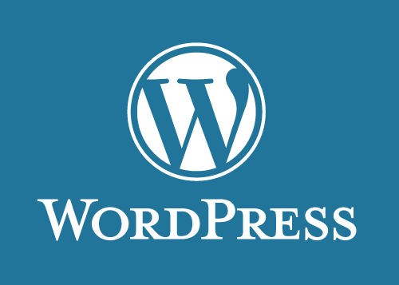
Where Do You Go?
http://www.wordpress.org

Slide 5
How Could a Library Benefit?
It is simple to use. No user needs to have coding experience or expertise to use WordPress. It allows the user to follow a format.
It is customizable. As a part of Open Source Software, a library could tailor WP to fit its needs.
Multiple employees can make changes to it, and so several staff members could have the responsibility of keeping the website updated.
A large community is involved with WP, and so there are changes/updates made frequently that will keep the technology current.
If there are problems, there are a lot of online resources available to assist with website development.
If it is a part of a server, it is not tied down to only one computer in the library. It can even be updated on a mobile device.
It’s FREE!! This is certainly a benefit to libraries that have small or dwindling budgets.

Slide 6
What Type of Library Would Use It?
WordPress could be used by just about any library:
K through 12 libraries or school media centers.
Public libraries, large or small
Academic libraries for a small or large university.
Special libraries.
The customizability makes it an option for just about any library, any size, any purpose.

Slide 7
Who Can Use It?
Staff
The director or any library staff could have the responsibility of using WP.
It is simple to use, but the more training and knowledge that the staff has, the better a product will be.
Most likely, someone in a leadership position would be in charge of the website, or someone in the IT department.
Patrons
A knowledgeable staff can help any patron that has a need for a WP based website.
Patrons looking to start a business webpage or even a blog would find WP very beneficial.
Large businesses, churches, and even branches of the government has utilized WordPress. It can be used by just about anyone.

Slide 8
Weigh it Out!
Advantages
WordPress becomes more popular, and therefore more reliable, every single day. The amount of resources available for WordPress gives me confidence in the product.
The simplicity of the site and the amount of information on the initial webpage allows the user to feel like they can use it easily.
It allows for many different types of interactive features on a website, which makes it look more professional as well as gives more options of usage for patrons/customers.
It’s FREE. Any up and coming business or anyone on a tight budget can use this to help their business or library..

Slide 9
Weigh it Out!
Disadvantages
The service is free, but for a library, that means that it doesn’t come with a 24/7 helpdesk.
If no one is dedicated to keep the site updated, the advantage of customizability goes to waste. It is completely up to the library on how it is utilized.
Though it is a simple and easy-to-use software, it takes some knowledge to make it more than just a basic website. If someone isn’t willing to take the responsibility or no one on staff has the knowledge, it can make the software difficult to use.

Slide 10
Similar Products
Open Source Content Management: (They are free)
Drupal (www.drupal.org )
Joomla! (www.joomla.org)
Opencms (www.opencms.org )
Closed Content Management:
CushyCMS (http://www.cushycms.com/en )
Telerik (http://www.telerik.com/ )
SharePoint (http://sharepoint.microsoft.com/en-us/Pages/default.aspx)

Slide 11
Would I Use WordPress?
The overall ease of use, the freedom to make the website as I want it, and the fact that it is free makes this product something I would definitely use. It’s beneficial for a business or for a personal website, and both of those options are something I would look into. I think it is an extremely beneficial and worthwhile software, especially for libraries. Libraries are built to be a part of the community, so it makes sense for them to use a software that is free and made from a community.

Slide 12
References
Jones, K. L., & Farrington, P. (2011). WordPress as Library CMS. American Libraries, 42(5/6), 34.
Limpag, M. (2011, August 21). [Web log message]. Retrieved from http://max.limpag.com/article/wordpress-open-source-cms-2011/
Wehr, L. (2011, April 05). Marshable business. Retrieved from http://mashable.com/2011/04/05/best-cms-for-business/
http://wordpress.org/. (n.d.). Retrieved from WordPress.

